Slide 1


Noida Institute of Engineering and Technology, Greater Noida
UNDERSTANDING BLOCK CHAIN FOR ENTERPRENEURISES
UNIT 3
Unit: 3
UNDERSTANDING BLOCK CHAIN FOR ENTERPRENEURISES
(ACSAI0601)
Ms. Barkha Bhardwaj Assistant Professor
B.Tech AI
Course Details (B Tech 6th Sem)

Slide 2
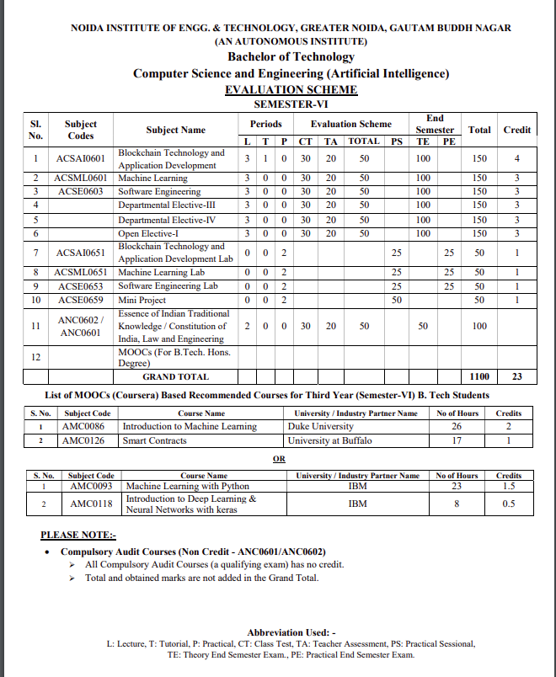
Noida Institute of Engineering and Technology, Greater Noida

Slide 3
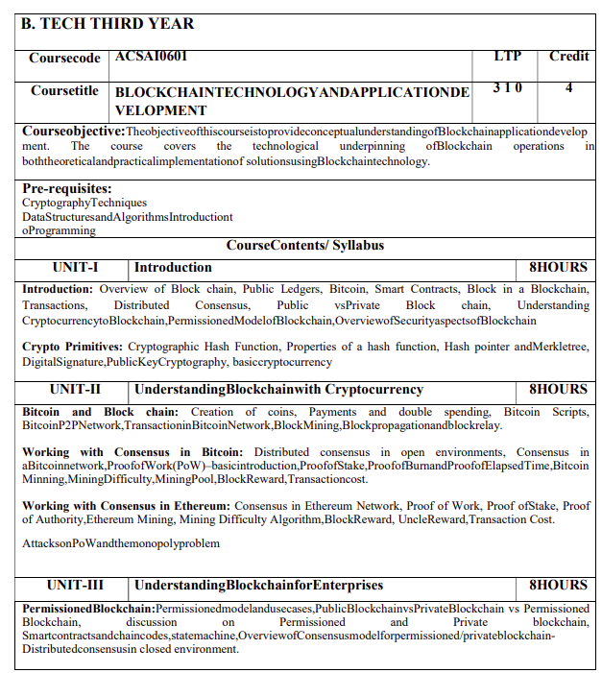
Noida Institute of Engineering and Technology, Greater Noida
Syllabus

Slide 4
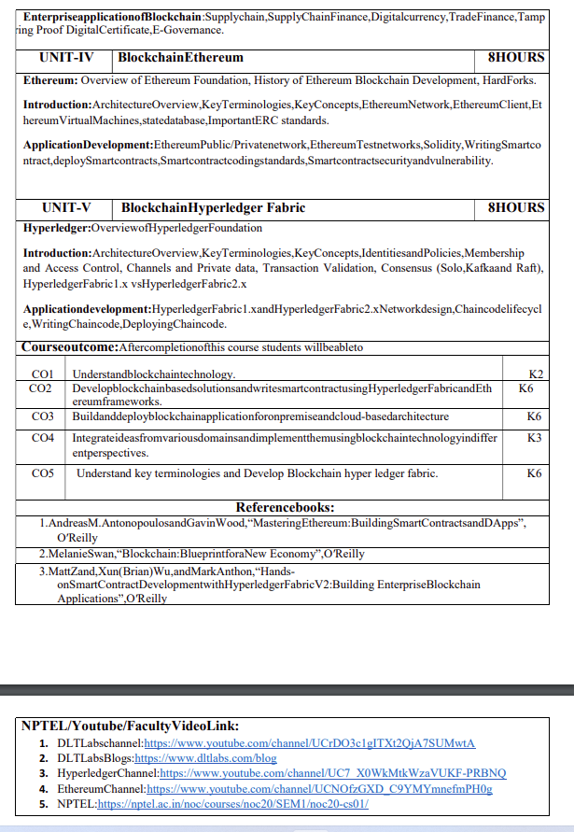
Noida Institute of Engineering and Technology, Greater Noida
Syllabus

Slide 5
Branch Wise Applications
It can compute man-made problems as well as natural phenomena. Block Chain theory has a lot of applications in real life as well, such that in SCM,education ,security ,banking and many fields.

Slide 6
Course Objective
To assess blockchain applications in a structured manner.
To impart knowledge in block chain techniques and able to present the concepts clearly and structured.
To get familiarity with future currencies and to create own crypto token.

Slide 7
Course Outcome
Course Outcome (CO) |  | Bloom’s Knowledge Level (KL)
At the end of the course, the student will be able to understand
CO 1 | Understand block chain technology. |  | K2
CO 2 | Develop block chain based solutions and write smart contract using Hyper ledger Fabric and Ethereum frameworks. |  | K6
CO 3 | Buildanddeployblockchainapplicationforonpremiseandcloud-basedarchitecture |  | K6
CO 4 | Integrate ideas from various domains and implement them using block chain technology in differ ent perspectives. |  | K3
CO 5 | Understand key terminologies and Develop Block chain hyper ledger fabric. |  | K6

Slide 8
Program Outcomes
Engineering Graduates will be able to Understand:
1. Engineering knowledge
2. Problem analysis
3. Design/development of solutions
4. Conduct investigations of complex
5. Modern tool usage
6. The engineer and society
7. Environment and sustainability
8. Ethics
9. Individual and team work
10. Communication
11. Project management and finance
12. Life-long learning

Slide 9
CO-PO and PSO Mapping
CO-PO correlation matrix of Block Chain and Application Development(ACSAI0601)
 | PO1 | PO2 | PO3 | PO4 | PO5 | PO6 | PO7 | PO8 | PO9 | PO10 | PO11 | PO12
ACSAI0601 | 2 | 2 | 3 | 3 | 2 | 2 | - | - | 2 | 1 | - | 3
ACSAI0601 | 1 | 3 | 2 | 3 | 2 | 2 | - | 1 | 1 | 1 | 2 | 2
ACSAI0601 | 2 | 2 | 3 | 2 | 2 | 2 | - | 2 | 2 | 1 | 2 | 3
ACSAI0601 | 2 | 2 | 2 | 3 | 2 | 2 | - | 2 | 2 | 1 | 1 | 3
ACSAI0601 | 3 | 2 | 2 | 2 | 2 | 2 | - | 2 | 1 | 1 | 1 | 2
Average | 2 | 2.2 | 2.4 | 2.6 | 2 | 2 | - | 1.4 | 1.6 | 1 | 1.2 | 2.6
Mapping of Program Specific Outcomes and Course Outcomes:

Slide 10
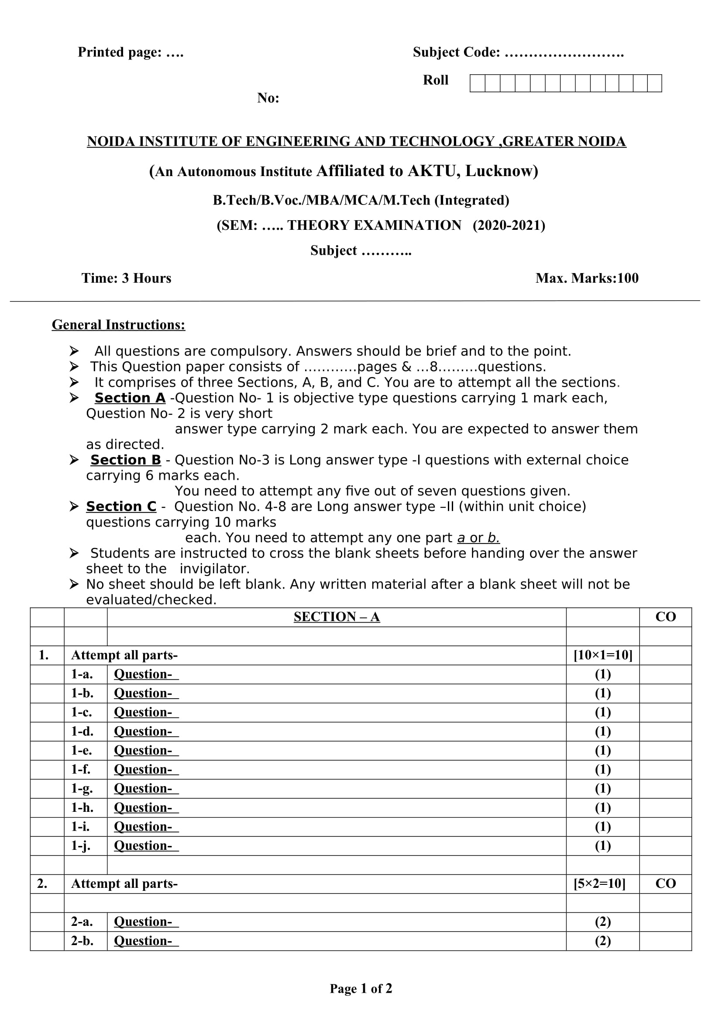
End Semester Question Paper Templates (Offline Pattern/Online Pattern)
End Semester Question Paper Templates (Offline Pattern/Online Pattern)

Slide 11
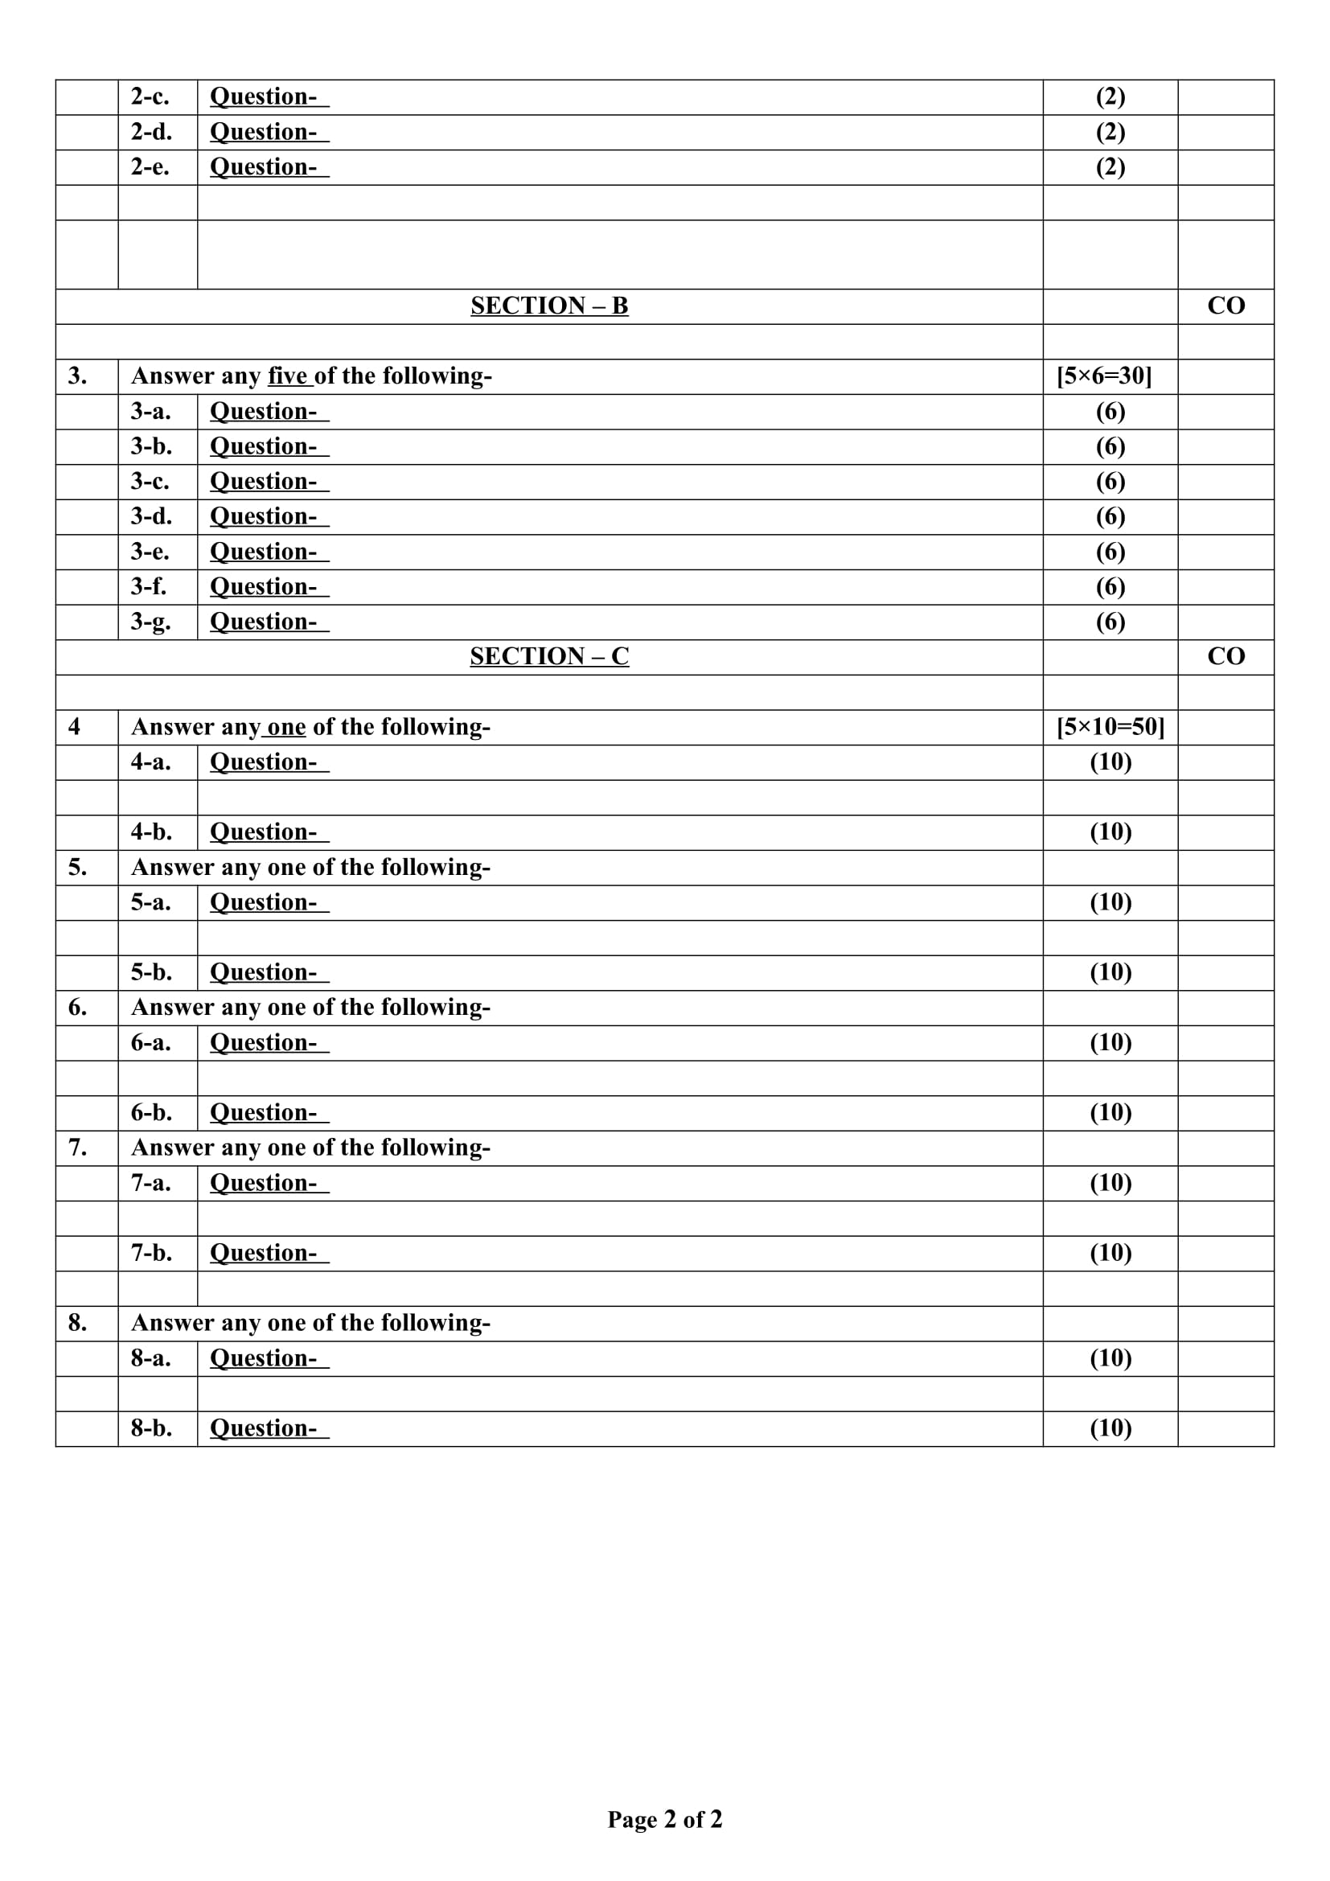
End Semester Question Paper Templates (Offline Pattern/Online Pattern)

Slide 12
Prerequisite and Recap
Brief input about the block chain and its introduction in the different fields. The basics of the Cyber security and cryptography are the requirements of this course.

Slide 13
Brief Introduction about the Subject with videos
Blockchain is a buzzword in today’s technology and this technology is described as the most disruptive technology of the decade.
Thus, Blockchain is used for the secure transference of items like money, contracts, property rights, stocks, and even networks without any requirement of Third Party Intermediaries like Governments, banks, etc.
DLTLabschannel:https://www.youtube.com/channel/UCrDO3c1gITXt2QjA7SUMwtA
DLTLabsBlogs:https://www.dltlabs.com/blog
HyperledgerChannel:https://www.youtube.com/channel/UC7_X0WkMtkWzaVUKF-PRBNQ
EthereumChannel:https://www.youtube.com/channel/UCNOfzGXD_C9YMYmnefmPH0g
NPTEL:https://nptel.ac.in/noc/courses/noc20/SEM1/noc20-cs01/

Slide 14
Contents
Brief Introduction about the Subject with videos
Permissioned Block Chain
Public Block Chain
Private block chain
Smart contract
Enterprrise Application of the block chain
Proof of digital certificate
E-goverance

Slide 15
Brief Introduction about the Subject with videos
Blockchain is a buzzword in today’s technology and this technology is described as the most disruptive technology of the decade.
Thus, Blockchain is used for the secure transference of items like money, contracts, property rights, stocks, and even networks without any requirement of Third Party Intermediaries like Governments, banks, etc.
DLTLabschannel:https://www.youtube.com/channel/UCrDO3c1gITXt2QjA7SUMwtA
DLTLabsBlogs:https://www.dltlabs.com/blog
HyperledgerChannel:https://www.youtube.com/channel/UC7_X0WkMtkWzaVUKF-PRBNQ
EthereumChannel:https://www.youtube.com/channel/UCNOfzGXD_C9YMYmnefmPH0g
NPTEL:https://nptel.ac.in/noc/courses/noc20/SEM1/noc20-cs01/

Slide 16
Unit Objective
To understand the basic concept of the permissioned block chain.
To understand the concepts of the cryptocurrency and smart contract.
To understand the enterprise applications of the block chain.
To understand the concept of the digital certificate.

Slide 17
Unit III Syllabus
Introduction :
Permissioned Block chain: Permissioned model and use cases, Public Block chain vs Private Block chain vs Permissioned Block chain, discussion on Permissioned and Private block chain, Smart contracts and chain codes ,state machine ,Overview of Consensus model for permissioned/private block chain Distributed consensus in closed environment.
EnterpriseapplicationofBlockchain:Supplychain,SupplyChainFinance,Digitalcurrency,
TradeFinance, Tampering Proof Digital Certificate,E-Governance.

Slide 18
What Is a Permissioned Blockchain?
A permissioned block chain is a distributed ledger that is not publicly accessible. It can only be accessed by users with permissions. The users can only perform specific actions granted to them by the ledger administrators and are required to identify themselves through certificates or other digital means.
You might consider the addition of permissioned users as an extra block chain security system. Administrators maintain an access control layer to allow certain actions to be performed only by certain identifiable participants. Records are kept within the block chain of who is involved in the transactions. This makes permissioned block chains different from public block chains. Permissioned block chains provide an additional level of security over typical block chain systems like Bitcoin, as they require an access control layer.
These block chains are favored by entities who require security, identity, and role definition within the block chain.
Permissioned block chains are becoming more common as businesses realize their benefits.

Slide 19
Understanding Permissioned Blockchains
Understanding Permissioned Blockchains
A blockchain can be built and accessed in multiple ways. Some blockchains need special permissions to read, access, and write information. Others only require that you have the ability to connect and can conduct work for the network. The intrinsic configuration of each blockchain controls the participants' transactions and defines their roles in which each participant can access and contribute to the blockchain.
It may also include maintaining the identity of each blockchain participant on the network. Such blockchains are called permissioned blockchains.
Difference Between Permissionless and Permissioned Blockchains
Permissioned blockchains are similar to permissionless blockchains because they use the same technologies. However, permissioned blockchains do not allow users to access the blockchain without identification.
For example, a bank may be running a permissioned blockchain operated through a designated number of nodes internal to the bank to track money transfers. You cannot access this blockchain because you don't have the permissions required. In contrast, you could join a permissionless blockchain like a cryptocurrency mining network once you have established a semi-anonymous account in that network.

Slide 20
Categories of the Block Chain
Much of the inner workings of the blockchains are the same. The key differences between them are:
Enterprise vs. Public use
Decentralization
Development
Transparency
Enterprise vs. Public Use
Bitcoin, the most popular cryptocurrency permissionless blockchain, allows anyone to participate in the network in the capacity of a full node or a contributing miner. Anyone can take a read-only role or make legitimate changes to the blockchain, like adding a new block or maintaining a full copy of the entire blockchain.
As blockchain uses grow and mature, more businesses and governments have realized the cost-saving benefits the technology introduces into an organization. As a result, permissioned blockchains have become popular among industry-level firms and enterprises, for which security, identity, and role definition are essential.
For instance, a manufacturer producing a product may use a permissioned blockchain that ties into its supply chain management. The transactions on this blockchain would likely involve logistics partners, financing banks, and other vendors involved in the supply and financing processes. Each entity would have its own level of transparency and permissions that it could use to streamline operations, track inventory, or monitor spending and invoicing.

Slide 21
What Is a Permissionless and a Permissioned Blockchain?
What Is a Permissionless and a Permissioned Blockchain?
A permissioned blockchain requires user approval to join and is generally used for enterprise purposes, whereas a permissionless blockchain is used for public purposes that require less transparency and control.
What are Permissioned Blockchains Used for?
Permissioned blockchains are generally used to manage supply chains, create contracts, verify payment between parties, and much more.
Can Ethereum be Permissioned?
Many cryptocurrency blockchains are permissionless. However, some, like Etherum, can be further developed into permissioned blockchains for use in environments that require it.

Slide 22
Smart Contracts​
Smart Contracts​
Smart contracts are revolutionizing the way how traditional contracts worked, which is why you need to know about them in this Ethereum tutorial. A smart contract is a simple computer program that facilitates the exchange of any valuable asset between two parties. It could be money, shares, property, or any other digital asset that you want to exchange. Anyone on the Ethereum network can create these contracts. The contract consists primarily of the terms and conditions mutually agreed on between the parties (peers).​
The primary feature of a smart contract is that once it is executed, it cannot be altered, and any transaction done on top of a smart contract is registered permanently—it is immutable. So even if you modify the smart contract in the future, the transactions correlated with the original contract will not get altered; you cannot edit them.​
The verification process for the smart contracts is carried out by anonymous parties of the network without the need for a centralized authority, and that’s what makes any smart contract execution on Ethereum a decentralized execution.​
The transfer of any asset or currency is done in a transparent and trustworthy manner, and the identities of the two entities are secure on the Ethereum network. Once the transaction is successfully done, the accounts of the sender and receiver are updated accordingly, and in this way, it generates trust between the parties.​
​
a) Smart Contracts Vs. Traditional Contract Systems​
In conventional contract systems, you sign an agreement, then you trust and hire a third party for its execution. The problem is that in this type of process, data tampering is possible. With smart contracts, the agreement is coded in a program. A centralized authority does not verify the result; it is confirmed by the participants on the Ethereum blockchain- based network. Once a contract is executed, the transaction is registered and cannot be altered or tampered, so it removes the risk of any data manipulation or alteration.​

Slide 23
Ethereum Virtual Machine​
It has all the conditions (requirements) for building the website. Once the code is written, it is uploaded and deployed on the Ethereum Virtual Machine (EVM).​
EVM is a runtime compiler to execute a smart contract. Once the code is deployed on the EVM, every participant on the network has a copy of the contract. When Elsa submits the work on Ethereum for evaluation, each node on the Ethereum network will evaluate and confirm whether the result given by Elsa has been done as per the coding requirements, and once the result is approved and verified, the contract worth $500 will be self-executed, and the payment will be paid to Elsa in ether. Zack’s account will be automatically debited, and Elsa will be credited with $500 in ether.
Ethereum Virtual Machine​
EVM, as mentioned above in this Ethereum tutorial, is designed to operate as a runtime environment for compiling and deploying Ethereum-based smart contracts. EVM is the engine that understands the language of smart contracts, which are written in the Solidity language for Ethereum. EVM is operated in a sandbox environment—basically, you can deploy your stand-alone environment, which can act as a testing and development environment, and you can test your smart contract (use it) “n” number of times, verify it, and then once you are satisfied with the performance and the functionality of the smart contract, you can deploy it on the Ethereum main network.​

Slide 24
Working of EVM​
Any programming language in the smart contract is compiled into the bytecode, which the EVM understands. This bytecode can be read and executed using the EVM. One of the most popular languages for writing a smart contract in Solidity. Once you write your smart contract in Solidity, that contract gets converted into the bytecode and gets deployed on the EVM. And thereby EVM guarantees security from cyberattacks.​
Working of EVM​
Suppose person A wants to pay person B 10 ethers. The transaction will be sent to the EVM using a smart contract for a fund transfer from A to B. To validate the transaction; the Ethereum network will perform the proof-of-work consensus algorithm.​
The miner nodes on Ethereum will validate this transaction—whether the identity of A exists or not, and if A has the requested amount to transfer. Once the transaction is confirmed, the ether will be debited from A’s wallet and will be credited to B’s wallet, and during this process, the miners will charge a fee to validate this transaction and will earn a reward.All the nodes on the Ethereum network execute smart contracts using their respective EVMs.​
​​

Slide 25
Consensus Models /Mechanism And trust Frame Work
Consensus Models /Mechanism And trust Frame Work
•Proof – of –Work Consensus Model
•Proof –of- Stake Consensus Model
•Round Robin Consensus Model
•Proof of Authority/Proof of Identity Consensus Model
•Proof of Elapsed Time Consensus Model

Slide 26
Proof – of –Work Consensus Model
Proof – of –Work Consensus Model
•In the proof of work (PoW) model, a user publishes the next block by being the first to solve a computationally intensive puzzle.
•The solution to this puzzle is the “proof” of their performed work. •The puzzle is designed such that solving the puzzle is difficult, but checking that a solution is valid is easy. •This enables all other full nodes to easily validate any proposed next blocks, and any proposed block that did not satisfy the puzzle would be rejected. •A common puzzle method is to require that the hash digest of a block header be less than a target value. •Publishing nodes make many small changes to their block header (e.g., changing the nonce) trying to find a hash digest that meets the requirement. For each attempt, the publishing node must compute the hash for the entire block header. Dr. Anil Kumar K.M -Block Chain Instruc

Slide 27
Hashing
Hashing the block header many times becomes a computationally intensive process. The target value may be modified over time to adjust the difficulty (up or down) to influence how often blocks are being published • Adjustments to the difficulty target is done to ensure that no entity can take over block production. •When a user receive completed block from another user, they need to discard it and proceed. As an example, consider a puzzle where, using the SHA-256 algorithm, a computer must find a hash value meeting the following target criteria (known as the difficulty level):
SHA256(“blockchain” + Nonce) = Hash Digest starting with “000000” SHA256("blockchain0") = 0xbd4824d8ee63fc82392a6441444166d22ed84eaa6dab11d4923075975acab938 (not solved)
SHA256("blockchain1") = 0xdb0b9c1cb5e9c680dfff7482f1a8efad0e786f41b6b89a758fb26d9e223e0a10 (not solved) …
SHA256("blockchain10730895") = 0x000000ca1415e0bec568f6f605fcc83d18cac7a4e6c219a957c10c6879d67587 (solved)

Slide 28
Proof of Stake Consensus Model
Proof of Stake Consensus Model
•The proof of stake (PoS) model is based on the idea that the more stake a user has invested into the system, the more likely they will want the system to succeed, and the less likely they will want to subvert it.
•Stake is often an amount of cryptocurrency that the blockchain network user has invested into the system (through various means, such as by locking it via a special transaction type, or by sending it to a specific address, or holding it within special wallet software).
•Once staked, the cryptocurrency is generally no longer able to be spent. •Proof of stake blockchain networks use the amount of stake a user has, as a determining factor for publishing new blocks.
•Thus, the likelihood of a blockchain network user publishing a new block is tied to the ratio of their stake to the overall blockchain network amount of staked cryptocurrency
•With this consensus model, there is no need to perform resource intensive computations (involving time, electricity, and processing power) as found in proof of work. Since this consensus model utilizes fewer resources, some blockchain networks have decided to forego a block creation reward;

Slide 29
Proof of Stake Consensus Model
The reward for block publication is then usually the earning of user provided transaction fees. Blockchain network uses the stake and can vary. There are four approaches: random selection of staked users, multi-round voting, coin aging systems and delegate systems. Regardless of the exact approach, users with more stake are more likely to publish new blocks.
When the choice of block publisher is a random choice (sometimes referred to as chain-based proof of stake), the blockchain network will look at all users with stake and choose amongst them based on their ratio of stake to the overall amount of cryptocurrency staked. So, if a user had 42% of the entire blockchain network stake they would be chosen 42 % of the time; those with 1 % would be chosen 1 % of the time.
When the choice of block publisher is a multi-round voting system (sometime referred to as Byzantine fault tolerance proof of stake) there is added complexity. The blockchain network will select several staked users to create proposed blocks. Then all staked users will cast a vote for a proposed block. Several rounds of voting may occur before a new block is decided upon. This method allows all staked users to have a voice in the block selection process for every new block.
When the choice of block publisher is through a coin age system referred to as a coin age proof of stake, staked cryptocurrency has an age property. After a certain amount of time (such as 30 days) the staked cryptocurrency can count towards the owning user being selected to publish the next block. The staked cryptocurrency then has its age reset, and it cannot be used again until after the requisite time has passed.

Slide 30
Round Robin Consensus Model
Round Robin Consensus Model
•Round Robin is a consensus model that is used by some permissioned blockchain networks.
•Within this model of consensus, nodes take turns in creating blocks.
•Round Robin Consensus has a long history grounded in distributed system architecture.
•To handle situations where a publishing node is not available to publish a block on its turn, these systems may include a time limit to enable available nodes to publish blocks so that unavailable nodes will not cause a halt in block publication. This model ensures no one node creates the majority of the blocks. It benefits from a straightforward approach, lacks cryptographic puzzles, and has low power requirements.
Since there is a need for trust amongst nodes, round robin does not work well in the permissionless blockchain networks used by most cryptocurrencies.
•This is because malicious nodes could continuously add additional nodes to increase their odds of publishing new blocks. In the worst case, they could use this to subvert the correct operation of the blockchain network.

Slide 31
Proof of Authority/Proof of Identity Consensus Model
Proof of Authority/Proof of Identity Consensus Model “It takes 20 years to build a reputation and five minutes to ruin it. If you think about that, you’ll do things differently.”
•The proof of authority (also referred to as proof of identity) consensus model relies on the partial trust of publishing nodes through their known link to real world identities
•Publishing nodes must have their identities proven and verifiable within the blockchain network (e.g., identifying documents which have been verified and notarized and included on the blockchain).
•The idea is that the publishing node is staking its identity/reputation to publish new blocks.
•Block chain network users directly affect a publishing node’s reputation based on the publishing node’s behavior.
•Publishing nodes can lose reputation by acting in a way that the blockchain network users disagree with, just as they can gain reputation by acting in a manner that the block chain network users agree with.
•The lower the reputation, the less likelihood of being able to publish a block. •Therefore, it is in the interest of a publishing node to maintain a high reputation. This algorithm only applies to permissioned block chain networks with high levels of trust.

Slide 32
Proof of Elapsed Time Consensus Model Within the proof of elapsed time (PoET)
Proof of Elapsed Time Consensus Model Within the proof of elapsed time (PoET) consensus model, each publishing node requests a wait time from a secure hardware time source within their computer system. The secure hardware time source will generate a random wait time and return it to the publishing node software. Publishing nodes take the random time they are given and become idle for that duration.
Once a publishing node wakes up from the idle state, it creates and publishes a block to the blockchain network and the entire process starts over. This model requires ensuring that a random time was used, since if the time to wait was not selected at random, a malicious publishing node would just wait the minimum amount of time by default to dominate the system.
This model also requires ensuring that the publishing node waited the actual time and did not start early. These requirements are being solved by executing software in a trusted execution environment found on some computer processors (such as Intel’s Software Guard Extensions5 , or AMD’s Platform Security Processor6 , or ARM’s TrustZone).
Verified and trusted software can run in these secure execution environments and cannot be altered by outside programs. A publishing node would query software running in this secure environment for a random time and then wait for that time to pass.
After waiting the assigned time, the publishing node could request a signed certificate that the publishing node waited the randomly assigned time. The publishing node then publishes the certificate along with the block

Slide 33
51% Attack
51% Attack
•A 51% attack is used to describe the unfortunate event that a group or single person gains more than 50% of the total mining power.
•If that happened in a Proof of Work blockchain like Bitcoin, it would allow the person to make changes to a particular block. If this person was a criminal, they could alter the block for their gain.
•A recent example of a 51% attack happened against the Verge blockchain, which allowed the hacker to walk away with 35 million XVG coins. At the time of the attack, this amounted to a realworld value of $1.75 million!
•When using a Proof of Stake consensus mechanism, it would not make financial sense to attempt to perform a 51% attack. For this to be achieved, the bad actor would need to stake at least 51% of the total amount of cryptocurrency in circulation. The only way they could do this is to purchase the coins on the open market.
•If they decided to buy an amount this substantial, then the real-world value of the coin would increase along the way. As a result, they would end up spending significantly more than they could gain from the attack.

Slide 34
Enterprise Blockchain
An "enterprise blockchain" is a type of permissioned blockchain that can be used to streamline business processes at scale, such as track supply chain goods or settle global payments.
Corporations believe this type suits their needs better than a public blockchain network, such as Bitcoin, because the visibility of their data can be restricted to a select group of people.
While there are different types of blockchains, they are all essentially digital records of financial transactions and data that are shared among a group of entities. They also use cryptography to make it difficult for malicious agents to manipulate the history of previous transactions.

Slide 35
Permissioned Blockchains
A vast majority of enterprise blockchains are "permissioned blockchains," meaning companies have direct control over them. For instance, they can block transactions that do not comply with their rules, or if law enforcement asks them to do so.
This is one of the biggest differences that sets permissioned ledgers aside from public ones like the one Bitcoin is built on. Public blockchains exist outside the control of any one company or government and are resistant to censorship. This is why bitcoin and other cryptocurrencies have been used successfully to circumvent international sanctions and even combat domestic cases of extortion.

Slide 36
What are the types of enterprise blockchains?
While companies aren't keen on this aspect, many have determined that they might be able to use the underlying technology to revolutionize payments and other areas of business.
Some of the main characteristics of enterprise blockchains include:
Accountability: Each node in the network – which each holds a copy of the transaction history – is known and can be held accountable for its actions. For example, often enterprise blockchains are shared by a few companies or financial entities in a cooperative format.
Permissioned: Only users who have permission can use the blockchain. The network owner(s) can choose who's allowed to use it and who's not.
Mutable: If all entities managing the network agree, the data can be changed.
Scalability: Because enterprise blockchains are typically not as decentralized as Bitcoin, they can easily support more transactions at the base layer.
What are the types of enterprise blockchains?
Enterprise blockchains are generally permissioned, falling into two categories:
Private: A central party determines the rules of the network and can change them at will. This central party determines who can contribute to the network by, for example, validating new transactions. JPMorgan’s jpmcoin falls into this category.
Consortium: A group of two or more parties jointly define the network rules, and each entity can contribute to the network. The Facebook-backed libra (now diem) currency falls into this category.
Enterprises could also conceivably use a public ledger system like Bitcoin, but most choose not to. Microsoft's identity project ION is an outlier for doing so.

Slide 37
What are the types of enterprise blockchains?
Blockchain technology is a technology that has many use cases. It became known for cryptocurrency, as the first cryptocurrency, Bitcoin, was also the first use case for blockchain technology [4]. This chapter will show how blockchain technology is much more versatile and can be used in supply chains in order to manage complex supply chains efficiently and accurately.

Slide 38
Problems intrinsic to traditional supply chains
Problems intrinsic to traditional supply chains
Supply chain management manages the flow of material, money, and information. In this chapter, we will concentrate only on the material and the information flows. Material usually flows from the origin of the raw material to the consumer (downstream) and information flows both upstream and downstream in the supply chain. A simple supply chain showing the flow of material is shown in Figure 1.

Slide 39
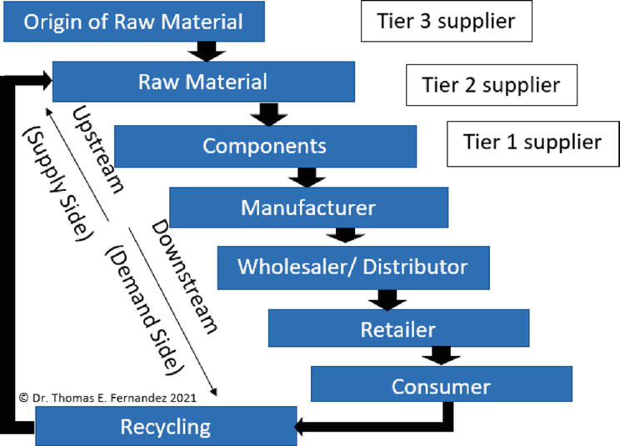

Slide 40
Blockchain technology can be used to build applications on which multiple parties can transact directly via a peer-to-peer network, without the need for a central authority to verify transactions. Each network participant has access to a shared ledger that immutably and cryptographically records all transactions, and there is no single network owner.
With blockchain, supply chain companies can document production updates to a single shared ledger, which provides complete data visibility and a single source of truth. Because transactions are always time-stamped and up to date, companies can query a product’s status and location at any point in time. This helps to combat issues like counterfeit goods, compliance violations, delays, and waste. In addition, immediate action can be taken during emergencies (e.g., in the case of product recalls), and regulatory compliance is ensured by the ledger audit trail. Moreover, by combining blockchain with smart technology like Internet of Things, supply chains can automate tracking the conditions of production, transportation, and quality control. Companies can also choose to share track and trace data with their customers as a way to verify product authenticity and ethical supply chain practices.

Slide 41
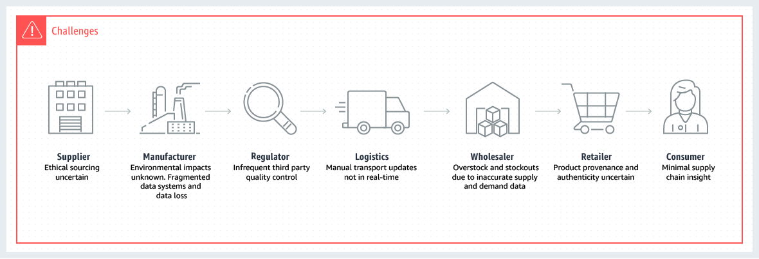

Slide 42
How does blockchain work in supply chain finance?
How does blockchain work in supply chain finance?
Blockchain technology has moved on from digital money and it is now being used in a wide range of industries including automotive, telecommunications, insurance, retail, entertainment, and healthcare. These types of industry use blockchain features to power various services, from billing and payments to logistics and planning, but their most prolific use is in supply chain finance:
Standard supply chain financing transaction
Limits visibility to buyer and lender. At each stage of the deal, only two of the three participants – buyer, supplier, lender – can see the activity. Not only does this friction put a brake on production and planning it puts the ‘blind’ party at a disadvantage and may also mask unethical behaviour or financial difficulties for buyer or supplier.

Slide 43
Transaction phase | Blind party
Buyer places order with supplier | None
Supplier asks lender for funds | Buyer
Supplier bills, ships good to buyer | Lender
Buyer pays supplier for goods | Lender
Supplier repays lender, closes loan | Buyer
Buyer returns unsold goods to Supplier, gets refund | None

Slide 44
Financing Transactions
Blockchain supply chain financing transaction
The entire blockchain is visible to all three parties. As each phase of the transaction occurs, a new block is added to the sequence. No party is blind. All parties can see what stage the transaction is at and may act accordingly – such as ‘just in time delivery’ or production development. It is not possible to obscure unethical behaviour or financial problems, which reduces risks and can lower costs such as insurance or financing fees.

Slide 45
Unit III Syllabus
Transaction phase | Blocks added and visible to all
Buyer places order with supplier | Order
Supplier asks lender for funds | Order/Loan
Supplier bills, ships good to buyer | Order/Loan/Bill/Ship
Buyer pays supplier for goods | Order/Loan/Bill/Ship/Payment
Supplier repays lender, closes loan | Order/Loan/Bill/Ship/Payment/Repay/Loan/Close
Buyer returns unsold goods to | Order/Loan/Bill/Ship/Payment/Repay/Loan/Close
Supplier, gets refund | /Returns/Refund

Slide 46
What are the advantages?
What are the advantages?
Blockchain technology offers many benefits when applied to supply chain finance:
Total visibility for all transaction participants
Better control of complex transactions involving multiple parties
Improved logistics and timing
Automated actions reduce need for manpower
Reduced risk
Lower costs such as insurance and financing fees
Less risk of unethical behaviour
Encourages more lenders to fund more deals
What are the disadvantages?
There are few negatives involved with blockchain I supply chain finance:
Low take-up by SMEs due to non-scientific bias against blockchain or lack of information
IT and methodology change for sales teams and buyer departments
Synchronisation between buyer/supplier/lender trading systems

Slide 47
How Blockchain is Transforming Trade Finance
How Blockchain is Transforming Trade Finance
In trade finance, blockchain technology is being used to create a transparent and secure system for exchanging goods and services.
The blockchain is a distributed ledger that allows for the recording of transactions between two parties without the need for a third party. Transactions are verified and confirmed by network nodes using cryptography.
The benefits of using blockchain in trade finance include:
Reduced Risk: Transactions are verified and confirmed by network nodes, eliminating the risk of fraud and other malicious activities.
Transactions are verified and confirmed by network nodes, eliminating the risk of fraud and other malicious activities. Improved Security: The decentralized nature of the blockchain makes it difficult for anyone to tamper with the data.
The decentralized nature of the blockchain makes it difficult for anyone to tamper with the data. Reduced Costs: The elimination of the need for third-party verification and confirmation reduces the costs associated with trade finance transactions.
The elimination of the need for third-party verification and confirmation reduces the costs associated with trade finance transactions. Increased Transparency: The transparency of the blockchain allows users to track the status of transactions and understand their overall financial situation.
The transparency of the blockchain allows users to track the status of transactions and understand their overall financial situation. Enhanced Speed: The blockchain can process transactions quickly and with minimal overhead, compared to traditional trade finance systems.
The blockchain can process transactions quickly and with minimal overhead, compared to traditional trade finance systems. Increased Efficiency: The use of smart contracts allows for automated and streamlined transactions between parties.
The use of smart contracts allows for automated and streamlined transactions between parties. Reduced Costs: By eliminating the need for third-party involvement, blockchain technology can reduce the costs associated with trade finance transactions.
The Benefits of Blockchain in Trade Finance
There are many benefits of blockchain in trade finance. Some of the benefits include:
1. Improved transparency and traceability.
2. Reduced time and cost associated with transactions.
3. Increased security and accuracy of records.
4. Enhanced trust and confidence between parties involved in a trade.
5. Increased efficiency and reduced costs associated with trade transactions.

Slide 48
E-Governance
— E-Governance system presents great opportunities for countries around the world offering government services online. Many countries have developed their E-governance systems to facilitate services for their citizen. However, the system suffers from serious challenges like security and privacy issues.
These challenges have led to a drastic reduction of public trust in the system. This paper carries out a study on existing studies on securing e-governance frameworks. After a thorough search process and critical quality evaluation, we identify sixteen relevant studies related to the E-governance across various platforms.
Our research reveals that use of blockchain technology is a strong option to secure E-government platforms and services.
Therefore, a new framework that integrates blockchain into e-governance is proposed with Saudi Arabia selected as a use case. The framework represents a hierarchical model and involves use of blockchain between De Militarized Zone (DMZ) and Secured Intranet zone. We believe our proposed framework would facilitate better and secure management of important functions within the organisation.

Slide 49
E-Governance systems are vulnerable to external and internal threats and attacks due to various reasons as discussed so far in this review. Watching for such attacks and taking appropriate remedial steps is necessary. Based on this, a newly proposed framework integrates blockchain technology into eGovernance in Saudi Arabia for security and privacy protection of the system and users. The study presented in this paper explores most existing literature on securing e-governance systems in different countries.
Our study reveals that there are several security and privacy issues which the existing e-government frameworks have not been able to address thoroughly. While many researchers have made efforts to address security challenges in e-Governance system, our study shows that, there are still some loopholes that need to be blocked. For example, most of the existing frameworks and models do not capture the necessary e-government security requirements; have a lack of trust in internet-mediated transactions, and unauthorized access to systems with the help of insiders.
To contribute to this growing area of research, this paper proposes a new framework that leverages blockchain to secure e-Governance, using Saudi Arabia as a use case. This proposed model brings decentralisation, access control, confidentiality, and privacy and trust into e-Government service. Also, researchers have not leveraged on blockchain technology to secure Saudi eGovernment system in the past.

Slide 50
Faculty Video Links, Youtube & NPTEL Video Links and Online Courses Details
Youtube/other Video Links
https://www.youtube.com/watch?v=SSo_EIwHSd4&vl=en
https://www.youtube.com/watch?v=RT7x0lQvSLk
https://www.youtube.com/watch?v=yubzJw0uiE4
https://www.khanacademy.org/economics-finance-domain/core-finance/money-and-banking/bitcoin/v/bitcoin-transaction-block-chains

Slide 51
Daily Quiz
What is the difference between blockchain and database?
What is Cryptocurrency?
What are the limitations of blockchain?
What is a 51% attack?
What is encryption? What is its role in Blockchain?
What is the difference between Proof-of-work and Proof-of-stake?
How does the security of a block works?
What is the principle on which blockchain technology is based on?
What are the different types of Blockchains?
Why is Blockchain a trusted approach?
Name the two types of records that are present in the blockchain database?

Slide 52
Weekly Assignment
What is the difference between public and private key?
Name the platforms that are actively developing Blockchain applications?
How does bitcoin use blockchain?
What is Consensus algorithm?
What do you know about Blockchain? What is the difference between Bitcoin blockchain and Ethereum blockchain?
What type of records can be kept in a Blockchain? Is there any restriction on same?
State difference between proof-of-work & proof-of-stake?

Slide 53
Quiz
Q 1. Each block of a Blockchain consists of which of the following?
A hash pointer to the previous block Timestamp List of transactions All of the above [Ans]
Q 2. Which of the following is first distributed blockchain implementation?
Bitcoin [Ans]
Ethereum
Q 3. Bitcoin is based on ________ blockchain?
Private
Public [Ans]
Public Permissioned
Permissioned
Q 4. Blockchain can be stored as which of the following?
A flat file A Database Both of the above [Ans] None of the above

Slide 54
Quiz
Q 5. In blockchain, blocks are linked ________?
Backward to the previous block [Ans] Forward to next block Not linked with each other
use blockchain?
Q 6. The primary benefit of immutability is…
Scalability
Improved Security
Tamper Proof
Increased Efficiency [Ans]
Q 7. Hash identifying each block in the Blockchain is generated using which of the following cryptographic algorithm?
SHA128 SHA256 [Ans]
Q 8. Blockchain forks can result in which of the following?
Multiple parent blocks Multiple children blocks [Ans]
Q 9. Which of the following is asymmetric encryption Algorithm?
Blowfish
Twofish RSA [Ans] Tripple D
Q 8. A block in the blockchain can never have more than one parent block?
True [Ans]
False
EA

Slide 55
Old Question Papers
NA

Slide 56
Expected Questions for University Exam
What is the difference between public and private key?
Name the platforms that are actively developing Blockchain applications?
How does bitcoin use blockchain?
What is Consensus algorithm?
What do you know about Blockchain? What is the difference between Bitcoin blockchain and Ethereum blockchain?
What type of records can be kept in a Blockchain? Is there any restriction on same?
State difference between proof-of-work & proof-of-stake?
What is the difference between blockchain and database?
What is Cryptocurrency?
What are the limitations of blockchain?
What is a 51% attack?
What is encryption? What is its role in Blockchain?
What is the difference between Proof-of-work and Proof-of-stake?
How does the security of a block works?
What is the principle on which blockchain technology is based on?

Slide 57
Faculty Video Links, Youtube & NPTEL Video Links and Online Courses Details
My Video :
https://youtu.be/rPD97AZ9W2U
https://youtu.be/QbBHCehF3xo
https://youtu.be/JRlJPlbOP7I
Youtube/other Video Links
https://www.youtube.com/watch?v=yubzJw0uiE4
https://www.youtube.com/watch?v=_160oMzblY8
https://www.youtube.com/watch?v=YJyXfjbBmc8
https://www.youtube.com/watch?v=ENrjn-lD1e8

Slide 58
Glosarry
51% Attack When more than 50% of the miners in a blockchain launch an attack on the rest of the nodes/users to attempt to steal assets or double spend.
Address Much like a URL, a blockchain address is the location to or from which transactions occur on the blockchain.
Alt-coin Any coin or token other than Bitcoin.
Attestation Ledger A register or account book created for the purpose of providing support/evidence of individual transactions. Normally, an attestation ledger is used to verify that a transaction has been carried out, or to verify the authenticity of products or transactions.
Bitcoin The first and most popular cyptocurrency based on DLT technology developed from a whitepaper written by Satoshi Nakamoto in 2008.

Slide 59
Summary
A blockchain is “a distributed database that maintains a continuously growing list of ordered records, called blocks.” These blocks “are linked using cryptography. Each block contains a cryptographic hash of the previous block, a timestamp, and transaction data. A blockchain is a decentralized, distributed and public digital ledger that is used to record transactions across many computers so that the record cannot be altered retroactively without the alteration of all subsequent blocks and the consensus of the network.”

Slide 60
References
1.AndreasM.AntonopoulosandGavinWood,“Mastering Ethereum:Building Smart Contracts and DApps”, O′Reilly 2.MelanieSwan,“Blockchain:Blueprint for a New Economy”, O′Reilly
3.MattZand, Xun(Brian)Wu, and MarkAnthon,“ Handson Smart Contract Development with Hyperledger FabricV2
4. Daniel Drescher, Block chain basics A non-technical introduction in 25 steps, Apress , 2017. Paul Vigna and Michael J.Casey.
5. The Age of Cryptocurrency, 2015. Supplementary Readings: Antonopoulos, Mastering Bitcoin : Unlocking Digital Cryptocurrencies.
6. Mastering Blockchain - Imar Bashir - Second edition - Packt - 2018. Satosh Nakamoto, Bitcoin : A peer-to-peer electronic Cash system.

Slide 61
Noida Institute of Engineering and Technology, Greater Noida
Thank You

